Slide 1
Breaking down the monolith in your SaaS application
Paolo Salvatori
Principal System Engineer
FastTrack for Azure - ISVs and Startups
@babosbird

Slide 2
Agenda
Cloud Journey
Monolithic Applications
Microservice-based Applications
API Gateways
Containers
Kubernetes
Tenancy models
Multitenancy in Kubernetes
AKS Reference Architectures

Slide 3
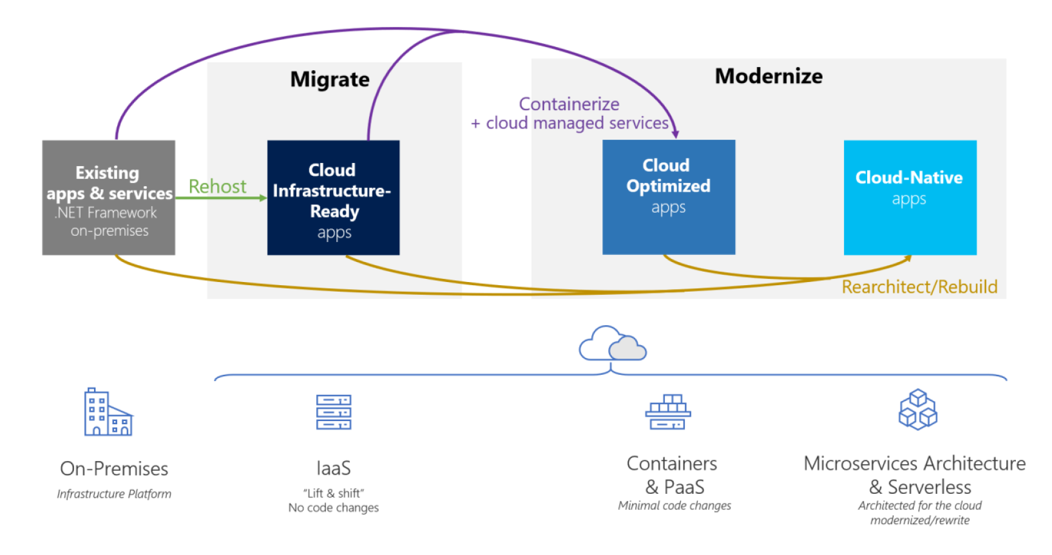
The Journey to the Cloud

Slide 4
Lift-and-Shift vs Cloud Optimized Apps vs Cloud Native Apps
Cloud Infrastructure-Ready applications | Cloud Optimized applications | Cloud-Native applications
Migrate / Lift and shift | Modernize
Application’s Compute Target
Applications deployed to VMs in Azure | Monolithic or N-Tier apps deployed to Azure App Service, Azure Container Instance (ACI), VMs with containers, AKS (Azure Kubernetes Service) | Containerized microservices on Azure Kubernetes Service (AKS), and/or serverless microservices based on Azure Functions.
Data Target
SQL or any relational database on a VM | Azure SQL Database Managed Instance or another managed database in the cloud. | Fined-grain databases per microservice, based on Azure SQL Database, Azure Cosmos DB, or another managed database in the cloud.
Advantages
No re-architecting, no new code Least effort for quick migration Least-common denominator supported in Azure Basic availability guarantees After moving to the cloud, it’s easier to modernize even more | No re-architecting Minimal code/config changes Improved deployment and DevOps agility to release because of containers Increased density and lower deployment costs Portability of apps and dependencies Flexibility of host targets: PaaS approaches or IaaS | Architect for the cloud, you get the best benefits from the cloud, but new code is needed Microservices cloud-native approaches Modern mission-critical applications Fully managed services Optimized for scale Optimized for autonomous agility by subsystem Built on deployment and DevOps
Challenges
Smaller cloud value, other than shift in operating expense or closing datacenters Very little is managed: No OS or middleware patching; might require immutable infrastructure solutions, like Terraform, Spinnaker, or Puppet | Containerizing is an additional step in the learning curve for developers and IT Operations DevOps and CI/CD pipelines is usually ‘a must’ for this approach. If not currently present in the culture of the organization, it might be an additional challenge. | Requires re-architecture for cloud native apps and microservice architectures and usually requires significant code refactoring or rewriting when modernizing (increased time and budget) DevOps, CI/CD pipelines are a must for this approach It often requires a culture change in the organization

Slide 5
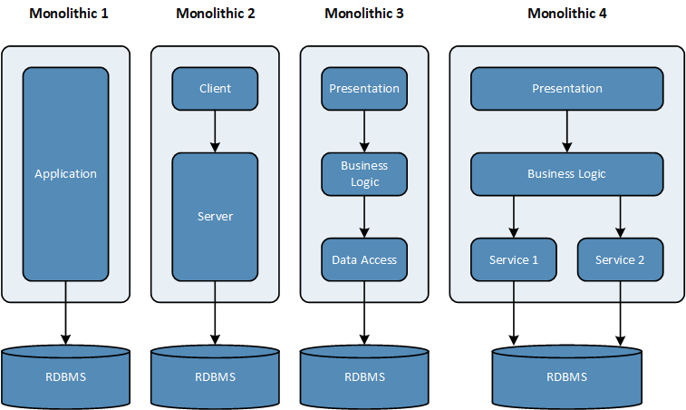
Monolithic Applications: Definition
Definitions:
A monolithic application is a single-tiered software application in which the user interface and data access code are combined into a single program from a single platform.
A monolithic application is an application system in which all the relevant modules are packaged together as a single deployable unit of execution. For example, it might be a Java Web Application running on Tomcat or an ASP.NET application running on IIS.
User interface, application logic, and data access are included in a single codebase.
All application artifacts are contained in a single big deployment.

Slide 6
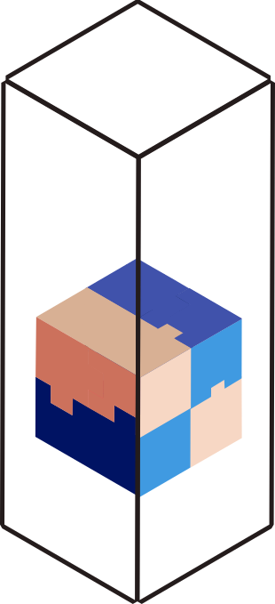
Pros and Cons of Monolithic Solution
Pros
Easy development and deployment
Performance: fast in-process calls
Cons
The individual parts of the system cannot be scaled independently, because they are tightly coupled.
Scaling accomplished by cloning the entire app
It is hard to maintain the code because
Components are tightly coupled and have hard dependencies.
Multiple teams work at different parts of the same codebase in parallel
Testing becomes harder, increasing the probability of introducing vulnerabilities.

Slide 7
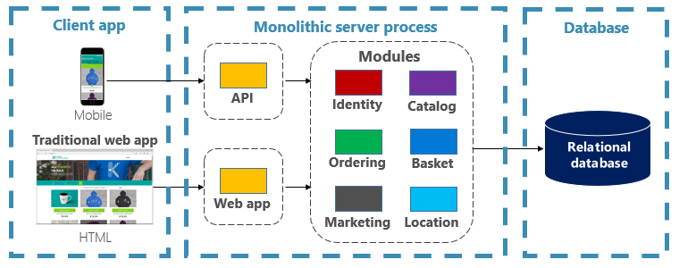
Is Monolith bad?
Not all is bad. Monoliths offer some distinct advantages.
Many successful apps that exist today were created as monoliths.
You don’t need to migrate all your apps to microservices.
Adopt microservices only if they bring you a competitive advantage in terms of flexibility, agility, cost savings, time to market, not because Kubernetes is the new black.

Slide 8
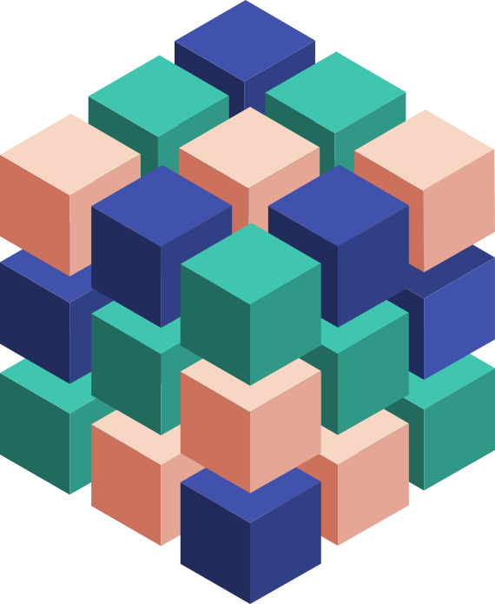
What is a Service?
Code solving a domain-specific problem
Built by a small team using a specific technology stack
Exposes features to caller via a well-defined API contract
Degrades gracefully when dependent services fail
Can be upgraded & scaled independently of other services
Dividing a big service into smaller services is often referred to as a microservices architecture

Slide 9
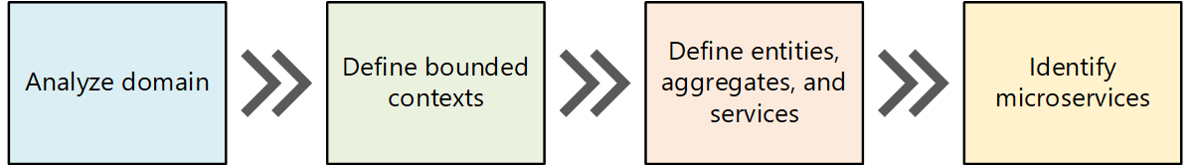
What is a Microservice?
A microservice-based architecture is an approach to building a server application as a set of small services.
Each microservice runs in its own process or container and communicates with other services using protocols such as HTTP/REST, WebSockets, gRPC, AMQP, etc.
Each microservice implements a specific end-to-end domain or business capability
Developed autonomously and independently deployed.
Each microservice should own its related domain data model and domain logic and could use different data repositories (SQL, NoSQL) and different programming languages.
Use Domain-driven design (DDD) and Bounded Contexts to identify a set of loosely coupled and cohesive microservices.

Slide 10
Microservices…
Do one thing well
Manage independent code and state
Are generally developed by a small cross-functional team
Are built with task-appropriate languages/frameworks

Slide 11
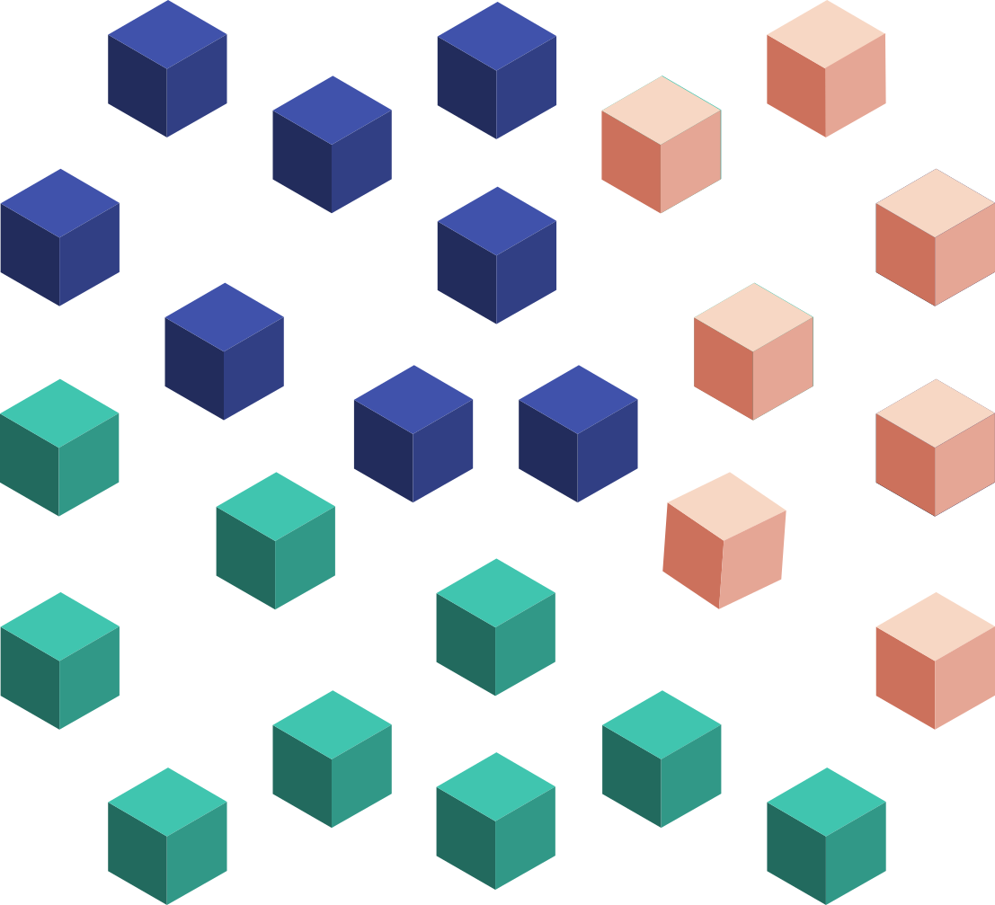
Microservices…
Do one thing well
Manage independent code and state
Are generally developed by a small cross-functional team
Are built with task-appropriate languages/frameworks
Are loosely coupled
Communicate over well-defined interfaces/protocols
Have unique names (URI) that can be resolved
Are independently updated, versioned, deployed, and scaled

Slide 12
Microservice Architecture Benefits
Scale Independently
Different Technology Stacks
Photo Share Service
Thumbnail Service
Photo Share Service Node.js
Thumbnail Service .NET
Photo Share Service
Thumbnail Service
Photo Share Service
Thumbnail Service
Photo Share Service
Independent Deployments and Versioning
Eliminate Conflicting Dependencies
Photo Share Service
Photo Share Service V1
Thumbnail Service V1
SharedLib-v1
Thumbnail
Thumbnail Service V2
SharedLib-v7
Photo Share Service
Thumbnail
Service
SharedLib-v1
SharedLib-v7

Slide 13
Monolithic Deployment Approach
Microservices Deployment Approach
A traditional monolithic application has most of its functionality hosted by a few processes componentized with layers and libraries
Scales by cloning the app on multiple servers/VMs.
A microservice application segregates functionality into smaller services
Scale out by deploying each service independently with multiple instances across servers/VMs
Agile deployment

Slide 14
Data in Monolithic approach
Data in Microservices approach
All tiers share a single database
Tiers of specific technologies
Graph of interconnected microservices
State typically scoped to the microservice
Remote storage for cold data

Slide 15
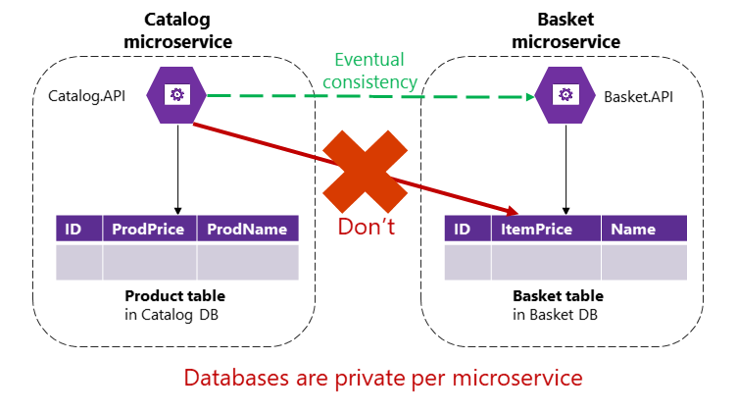
Data sovereignty per microservice
Each microservice owns its domain data and logic.
Data owned by each microservice is private to that microservice and should only be accessed either synchronously or asynchronously
Encapsulating data ensures that microservices are loosely coupled and can evolve independently of one another.
If multiple services were accessing the same data, schema updates would require coordinated updates to all the services, and this would break the microservice lifecycle autonomy.
No direct access to the database of another microservice
Local ACID transactions are allowed
No ACID transactions across microservice databases.
Use eventual consistency when a business process spans across multiple microservice.
Much harder to implement than simple SQL joins:
No integrity constraints between tables
No distributed transactions between separate databases.

Slide 16
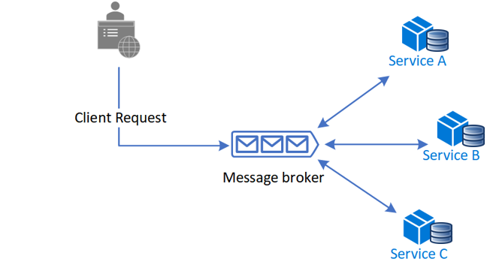
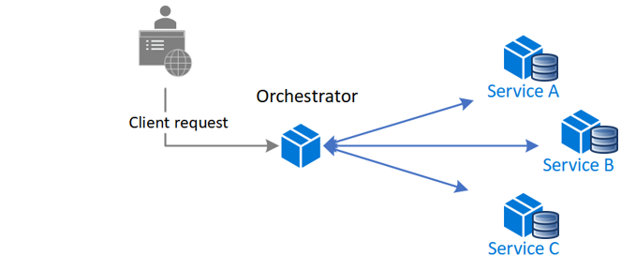
Saga Design Pattern
Saga design pattern is a way to manage data consistency across microservices in distributed transaction scenarios.
A saga is a sequence of transactions that updates each service and publishes a message or event to trigger the next transaction step.
If a step fails, the saga executes compensating transactions that undo the preceding transactions.
Choreography
Orchestration
Choreography is a way to coordinate sagas where participants exchange events without a centralized point of control.
With choreography, each local transaction publishes domain events that trigger local transactions in other services.
A centralized controller tells the saga participants what local transactions to execute.
The orchestrator handles all the transactions and tells the participants which operation to perform based on events.
The orchestrator executes saga requests, stores and interprets the states of each task, and handles failure recovery with compensating transactions.

Slide 17
Communications in a microservice-based architecture
Synchronous vs Asynchronous
Synchronous protocol: HTTP is a synchronous protocol. The client sends a request and waits for a response from the service before it can continue its task.
Asynchronous protocol: Protocols like AMQP use asynchronous messages. The client code or message sender usually doesn't wait for a response.
Single receiver vs multiple receivers
Each request must be processed by exactly one receiver or service
Each request can be processed by zero to multiple receivers. This type of communication must be asynchronous. An example is the publish/subscribe mechanism used in patterns like Event-driven architecture.
Minimize communications between separate microservices.
Communication between microservices should be asynchronous

Slide 18
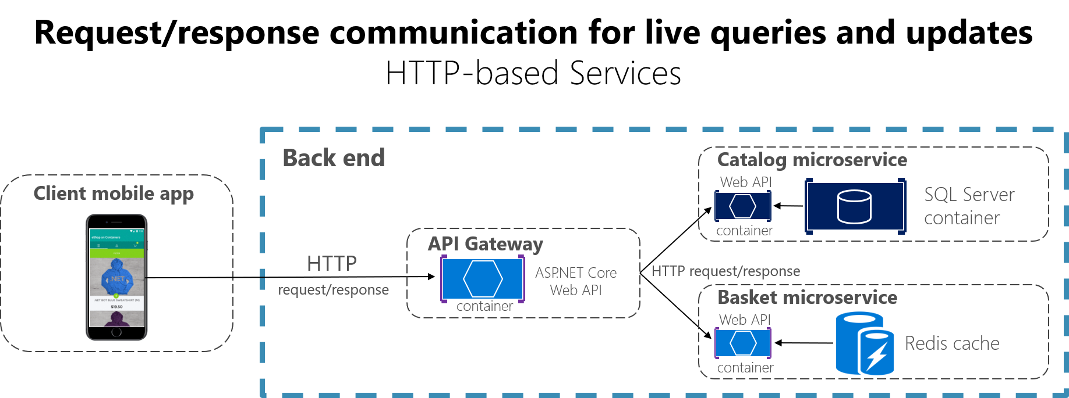
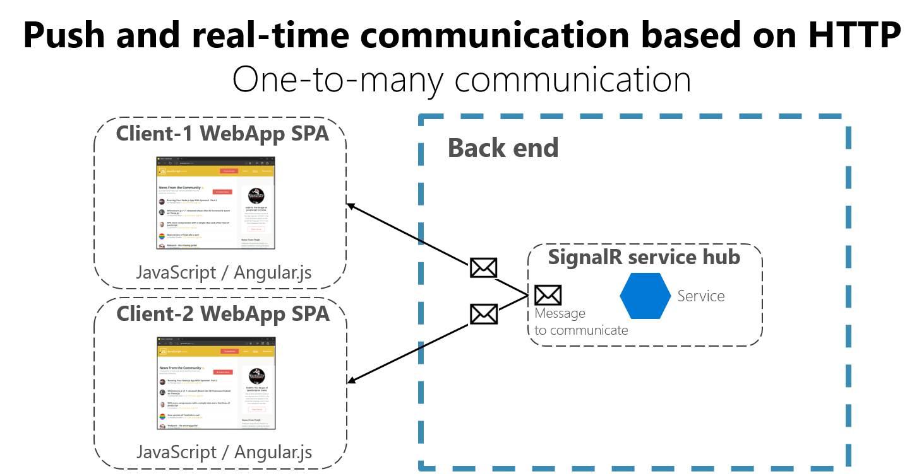
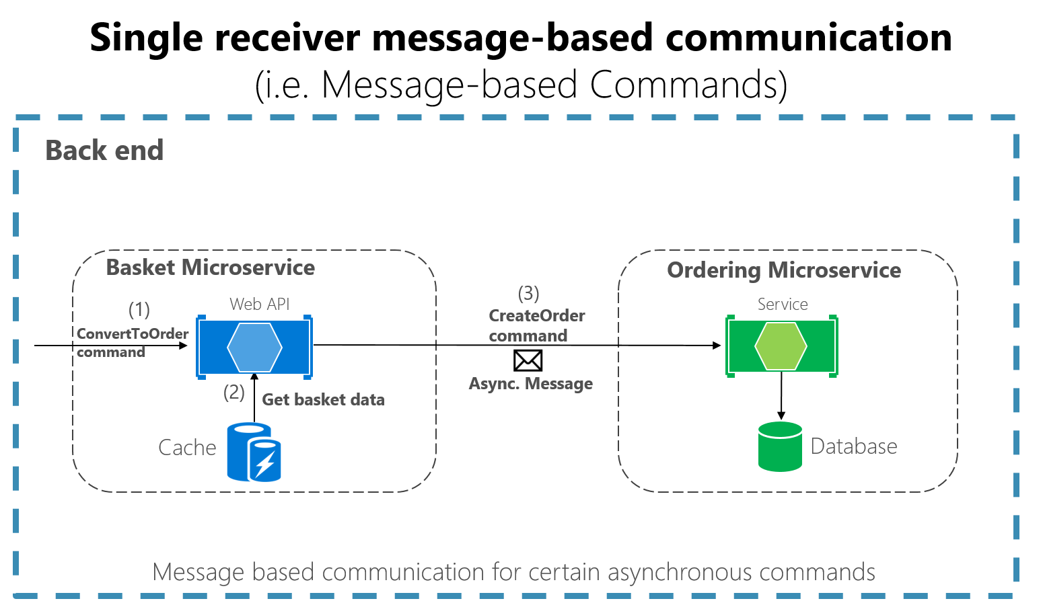
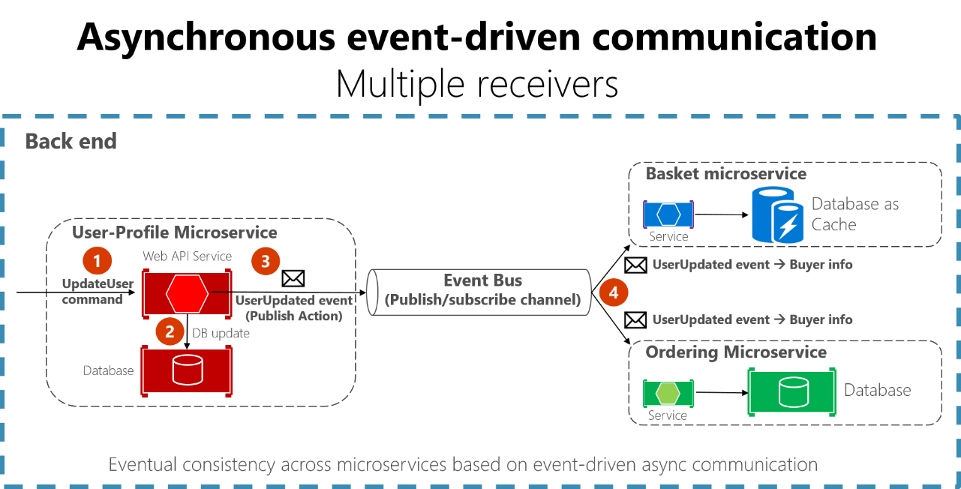
When a client uses request/response communication, it assumes that the response will arrive in a short time, typically less than a second.
A microservice can use WebSockets to push content to connected clients as the data becomes available
In asynchronous event-driven communication, a microservice publishes an event to notify other microservices that something happened in its domain. Other microservices can subscribe, receive and process events.
Single-receiver message-based communication is well suited for sending asynchronous commands from one microservice to another

Slide 19
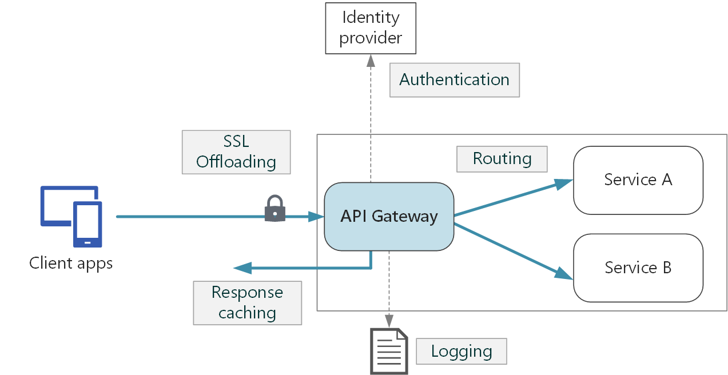
API Gateway Pattern (1 of 3)
Each microservice exposes a set of fine-grained endpoints.
An API Gateway aka "backend for frontend" (BFF) is a service that provides a single-entry point for groups of microservices.
An API gateway sits between clients and microservices and acts as a reverse proxy, routing requests from clients to services.
An API Gateway can implement cross-cutting concerns such as:
SSL termination
Redirect
Authentication / Authorization
IP allow/block list
Client rate limiting (throttling)
Logging and monitoring
Response caching
Web application firewall
GZIP compression
Servicing static content
Protocol bridging

Slide 20
API Gateway Pattern (2 of 3)
Without an API gateway, client apps need to send requests directly to the microservices and this raises problems:
Coupling: client application are coupled to internal microservices. Refactoring internal microservices can cause breaking changes to the client apps. Introducing a level of indirection via an API Gateway between client apps and a SaaS application allows you to start breaking down the monolith and gradually replace subsystems with microservices without violating the contract with client apps.
Chattiness: if a single page/screen needs to retrieve data from multiple microservices, this can result into multiple calls to fine-grained microservices
Security issues: without an API Gateway, all the microservices are directly exposed to the public internet making the attack surface larger.
Cross-cutting concerns: Each publicly exposed microservice must implement concerns such as authentication, authorization, SSL termination, client rate limiting, response caching, etc.

Slide 21
API Gateway Pattern (3 of 3)
Reverse Proxy Server: Nginx, HAProxy, and Traefik are popular reverse proxy servers that support features such as load balancing, SSL termination, and layer 7 routing. They can run on dedicated VMs or containers on Kubernetes.
Service Mesh Ingress Controller: If you are using a service mesh such as Linkerd or Istio, consider the features that are provided by the ingress controller for that service mesh. For example, the Istio ingress controller supports layer 7 routing, HTTP redirects, retries, and other features.
Azure Application Gateway: Application Gateway is a regional, fully-managed load balancing service that can perform layer-7 routing and SSL termination. It also provides a WAF
Azure Front Door: is a global layer 7 load balancer that uses the Microsoft global edge network to create fast, secure, and widely scalable web applications. It supports features such as SSL termination, response caching, WAF at the edge, URL-based routing, rewrite and redirections, it support multiple routing methods such as priority routing and latency-based routing.
Azure API Management: API Management is a turnkey solution for publishing APIs to both external and internal customers. It provides features that are useful for managing a public-facing API, including rate limiting, IP restrictions, and authentication and authorization using Azure Active Directory or other identity providers.

Slide 22
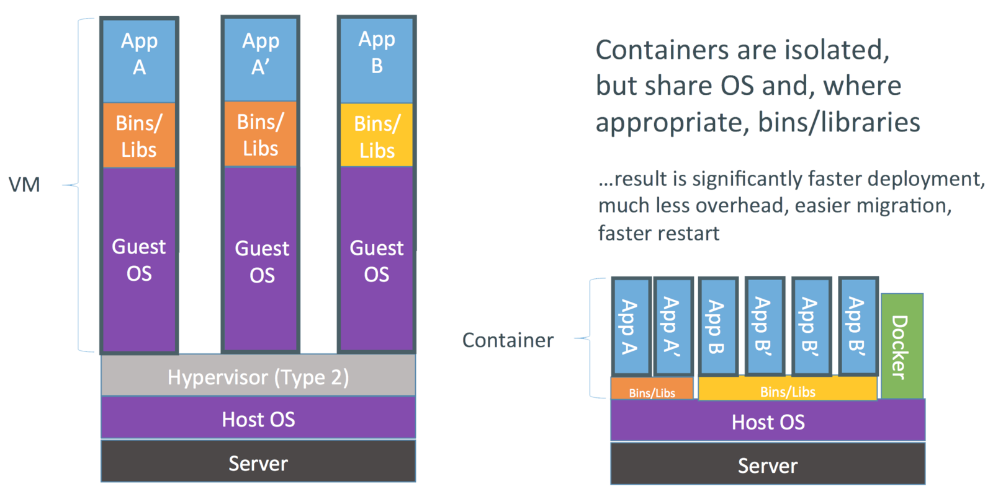
What is a container?
A lightweight, standalone, executable package of software that includes everything needed to run an application: code, runtime, system tools, system libraries and settings.
Containers != microservice
Containers can be used to host and scale a monolithic application on a container orchestrator such as Kubernetes.
A microservice doesn’t need to run in a container.
Containers are immutable by design.
Better density and better use of the system resources of the hosting machine.

Slide 23
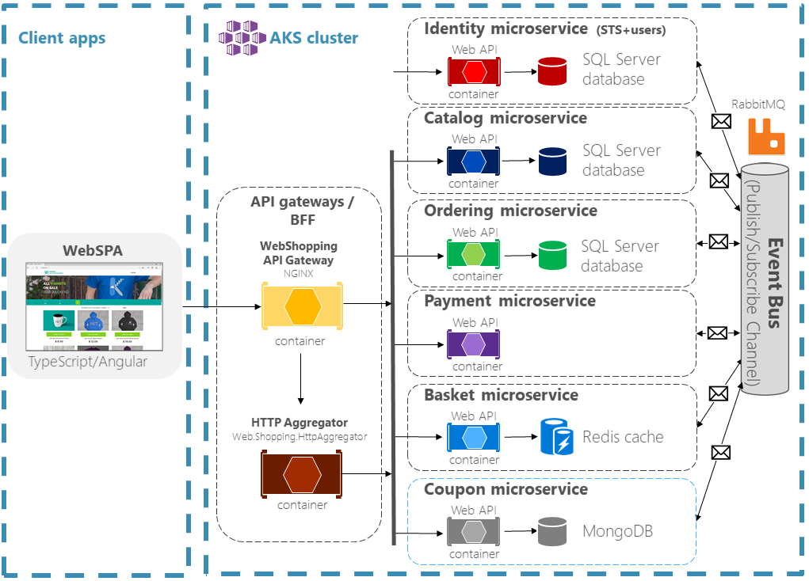
What is Kubernetes?
Kubernetes, also known as K8s, is an open-source system for automating deployment, scaling, and management of containerized applications
Kubernetes project is part of the Cloud Native Computing Foundation (CNCF)
Container scheduling and placing based on resource requirements and constraints
Automated changes rollouts and rollbacks
Service discovery and load balancing
Storage orchestration and mounting
Secret and configuration management
Batch execution
Horizontal pod and cluster autoscaling
IPv4/IIPv6 dual-stack
Self-healing: restarts containers that fail
Designed for extensibility (e.g., CSI drivers)
Better density allows to reduce the TCO
.NET Microservices Sample Reference Application

Slide 24
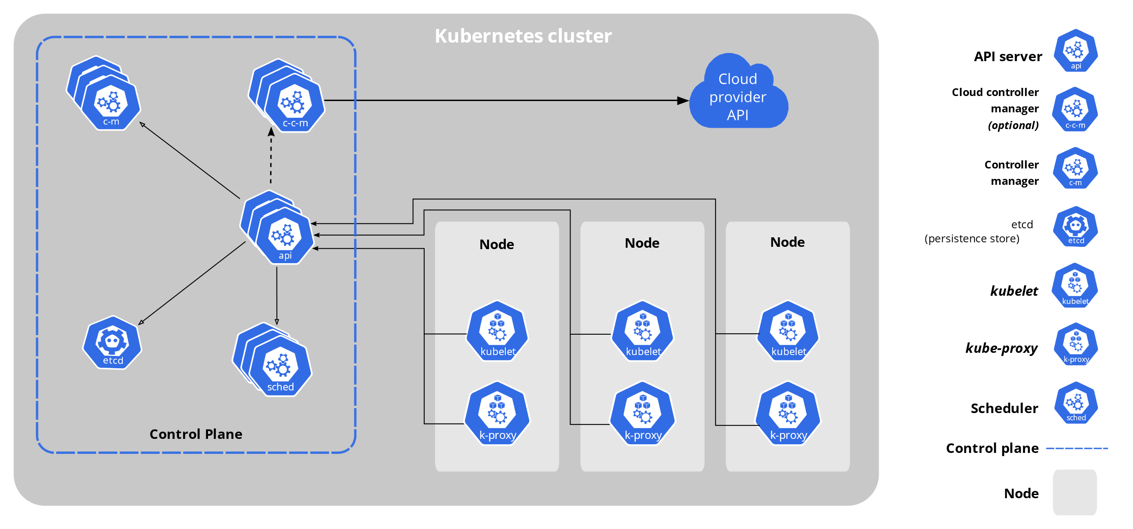
Main components of Kubernetes
Cluster: A control plane and one or more of agent or worker nodes.
Control plane: The collection of processes that control Kubernetes nodes. This is where all task assignments originate.
Kubelet: This service runs on each worker node and reads the container manifests and ensures the defined containers are started and running.
Pod: A group of one or more containers deployed to a single node. All containers in a pod share an IP address, IPC, hostname, and other resources such as mounted volumes.

Slide 25
More on Kubernetes
Kubernetes orchestration allows you to build application services that span multiple containers, schedule containers across a cluster, scale those containers, and manage their health over time.
Kubernetes eliminates many of the manual processes involved in deploying and scaling containerized applications.
Kubernetes can be used to deploy, run, and monitor both containerized monolithic applications and cloud-native, microservice-based applications that require rapid scaling
Kubernetes supports running Linux containers and Windows containers on separate sets of worker nodes called node pools
Kubernetes cluster can be hosted on cloud providers or on-premises

Slide 26
Kubernetes Ecosystem
Docker
Open-source software platform to build, deploy and manage application containers on a common operating system (OS), with an ecosystem of allied tools.
Service Proxy:
Load balancing, SSL termination, and layer 7 routing (Nginx, HAProxy, Traefik, AGIC, etc.).
They can run on dedicated VMs or containers on Kubernetes.
Service Mesh:
Observability, security, and reliability features to applications by injecting these features at the platform layer rather than implementing these features at the app layer (Istio, Linkerd, Open Service Mesh, Consul, etc.).
Rich set of features to create connectivity between services, such as mutual TLS (mTLS) and request routing, timeouts, retries, and circuit breaking by using the side-car container design pattern.
Monitoring and Observability:
Cluster and workloads observability, monitoring and Request Tracing via Prometheus, Grafana, Jaeger.
Helm:
Package manager for Kubernetes. Helm charts helps you package, install, and upgrade complex Kubernetes applications and their dependencies.
GitOps:
GitOps is a way of implementing Continuous Deployment for cloud native applications (Flux, Argo CD)

Slide 27
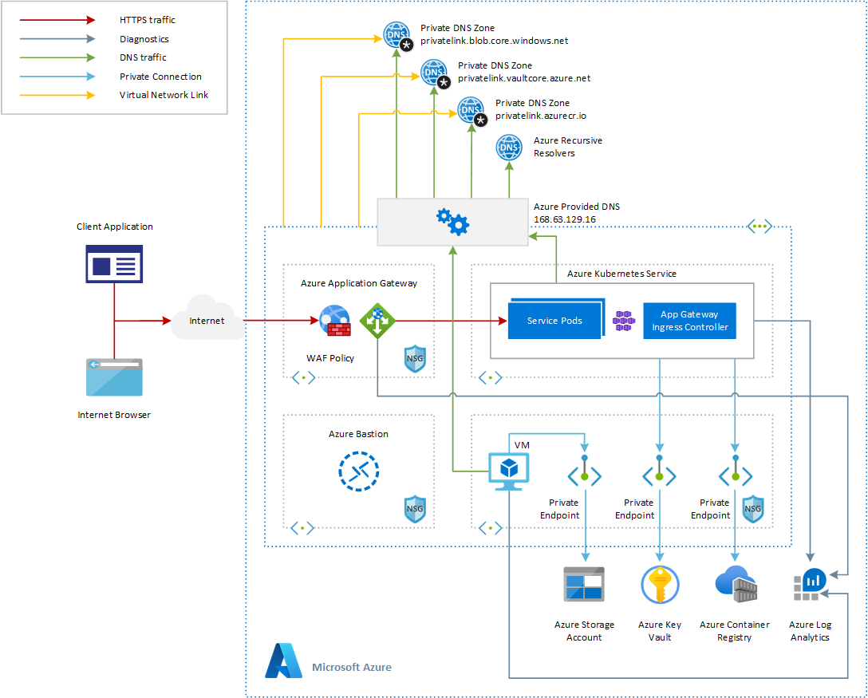
Kubernetes on Azure
Azure provides a fully managed Kubernetes service called Azure Kubernetes Services.
Azure Kubernetes Service (AKS) simplifies deploying a managed Kubernetes cluster in Azure by offloading the operational overhead to Azure.
As a hosted Kubernetes service, Azure handles critical tasks, like health monitoring and maintenance like agent nodes patching.
Since Kubernetes masters are managed by Azure, you only manage and maintain the agent nodes.
AKS is free: you only pay for the agent nodes within your clusters, not for the master nodes or the service.

Slide 28
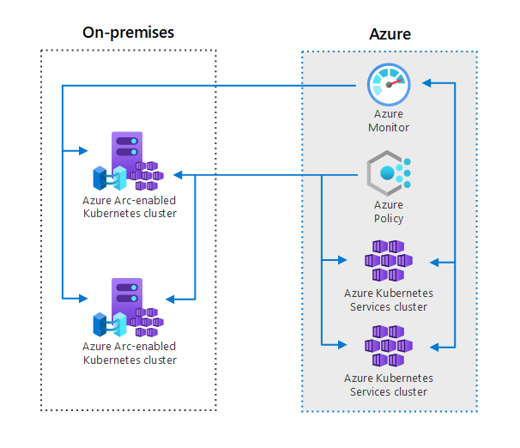
Azure Arc for Kubernetes
You can use Azure Arc to register Kubernetes clusters hosted on-premises or another cloud platform outside of Microsoft Azure, and use Azure tools to manage these clusters alongside clusters hosted in Azure Kubernetes Service (AKS)
Typical uses for this architecture include:
Managing on-premises Kubernetes clusters alongside clusters hosted in AKS for inventory, grouping, and tagging.
Monitoring Kubernetes clusters across hybrid environments using Azure Monitor.
Deploying and enforcing policies for Kubernetes clusters across hybrid environments using Azure Policy.
Deploying and enforcing GitOps using Azure Policy.

Slide 29
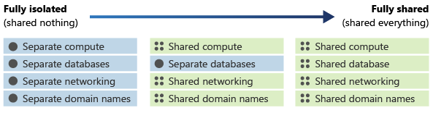
Multitenancy and Isolation
One of the biggest concerns when designing a multitenant architecture is the level of isolation that each tenant needs at different levels:
Security. If you share infrastructure between multiple tenants, you need to be careful not to access data from one tenant when returning responses to another.
Cost. Shared infrastructure can be used by multiple tenants, so it's cheaper.
Performance. If you're sharing infrastructure, your system's performance may suffer as more customers use it, since the resources may be consumed faster.
Reliability. If you're using a single set of shared infrastructure, a problem affecting one tenant's components can result in an outage for other tenants.

Slide 30
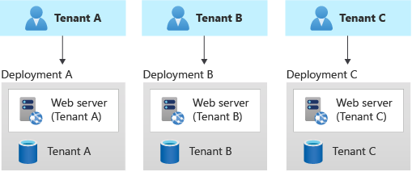
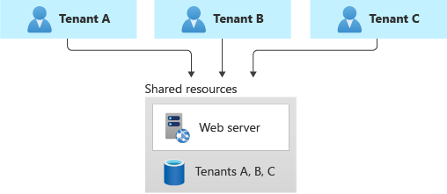
Single-tenant deployments
Multi-tenant deployments
In a single-tenant deployment model, you deploy a dedicated set of infrastructure for each tenant
Benefits
Tenant Isolation
Easy to charge back Azure costs to tenants
Reduced risk of data leakage
No noisy-neighbor issue
Risks
Cost efficiency is low
Coarse-grained density
In a multitenant architecture, tenants share some or all the computing resources and data repositories.
Benefits
Cost and operational efficiency
Better density for tenant applications
Risks
Noisy-neighbor problem as tenants share the same resources
Need to distribute tenants across multiple stamps to avoid hitting platform limits
Track, associate, and charge back Azure costs to tenants

Slide 31
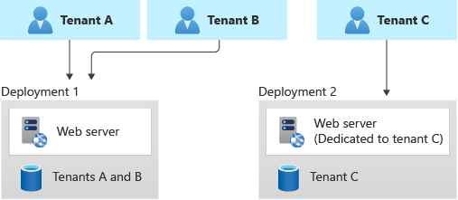
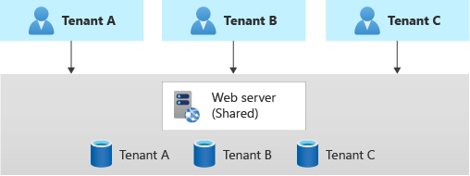
Vertically partitioned deployments
Horizontally partitioned deployments
Use a combination of single-tenant and multi-tenant deployments. For example, you might have most of your customers' data and application tiers on multi-tenant infrastructures, but you might deploy single-tenant infrastructures for customers who require a higher level of performance or data isolation.
Benefits
Cost benefits from the shared multitenant deployment
More pricing tiers for tenants
Risks
Codebase needs to support both single-tenant and multi-tenant deployments
Tenant applications share some components, for example compute resources, while maintaining other components with single-tenant deployments, for example the data repositories.
Benefits
Mitigates noisy-neighbor problem
Better density when hosting tenant applications on the same shared cluster
Risks
Distinct deployment and management lifecycle for single-tenant resource

Slide 32
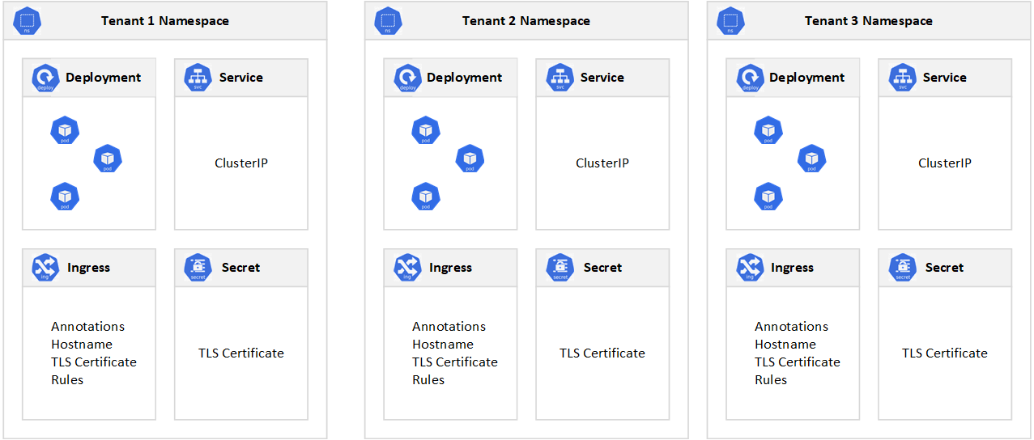
Kubernetes and multi-tenancy
Use a multitenant Kubernetes cluster as an alternative to managing many single-tenant dedicated clusters.
Separate each tenant-specific application and its Kubernetes resources into their own namespace.
Use Kubernetes RBAC and Network Policies to enforce tenant isolation at security and network level.
Use Limit Ranges and Resource Quotas to constrain resource allocations in a namespace, in terms of CPU and memory to avoid the noisy-neighbor issue.
Enforce safeguards and security standards on your K8S cluster using Policies (e.g., OPA via Azure Policy).
Define Pod Disruption Budgets, to make sure that a minimum number of pods is available.
Use Horizontal Pod Autoscaler to scale out and scale in the number of pods based on metrics (e.g., CPU)
Use Kubernetes autoscaling to dynamically scale out the number of the agent nodes of your cluster when the traffic increases.
Use Pod Topology Spread Constraints to spread pods across availability zones and nodes to guarantee intra-region resiliency.

Slide 33
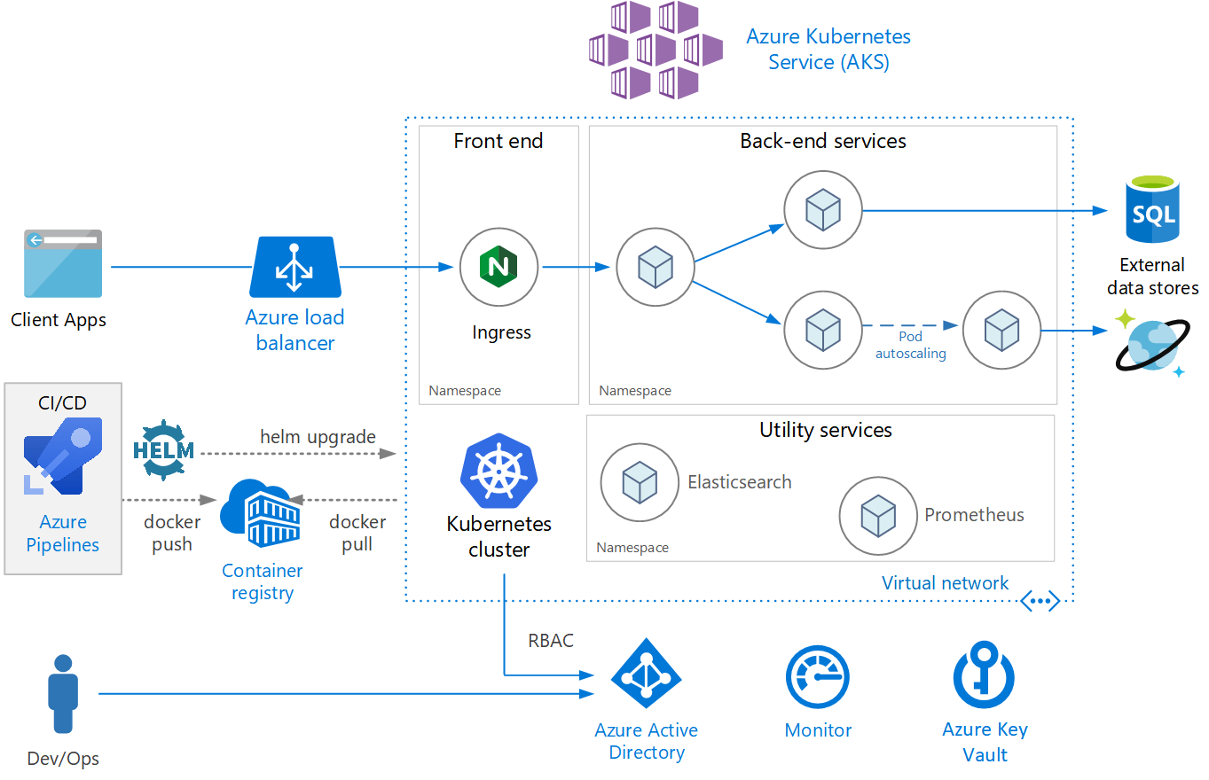
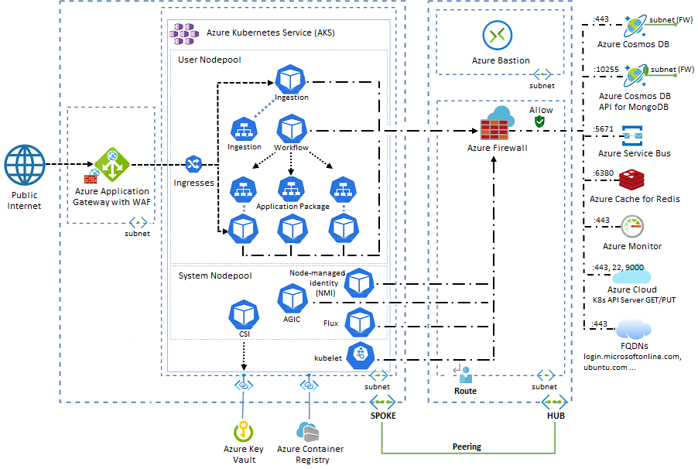
Microservices Reference Architectures
Microservices architecture on Azure Kubernetes Service (AKS)
Advanced Azure Kubernetes Service (AKS) microservices architecture

Slide 34
References
Microservices architecture style
Architectural considerations for a multitenant solution
.NET Microservices: Architecture for Containerized .NET Applications
Modernize existing .NET applications with Azure cloud and Windows Containers
Architecting Cloud Native .NET Applications for Azure
.NET Microservices Sample Reference Application
Advanced Azure Kubernetes Service (AKS) microservices architecture
Microservices architecture on Azure Kubernetes Service (AKS)
Use Application Gateway Ingress Controller (AGIC) with a multitenant Azure Kubernetes Service (AKS)
Using domain analysis to model microservices
GitOps for Azure Kubernetes Service

Slide 35


Contact us! saas-academy@microsoft.com
Visit for on demand content and upcoming webinars aka.ms/saas-academy
Your feedback matters! Share it with us https://forms.office.com/r/TP2uc132x4

